Slide 1

ELURU COLLEGE OF ENGINEERING AND TECHNOLOGY DEPARTMENT OF COMPUTER SCIENCE AND ENGINEERING INTELLIGENT ARCHITECTURE FOR DETECTING ADVANCED PERSISTENT ATTACKS IN ENTERPRISE ENVIRONMENTS
PROJECT GUIDED BY:
P. Spandana
Assistant Professor
Dept. of CSE
B.Tech, M.Tech
Team members:
R.Uma Satya Santosh (22JD1A05A0)
Sk.Abdul Hafeez (22JD1A05A5)
Y.Prasanthi (22JD1A05C1)
P.Harika (22JD1A0586)

Slide 2
ABSTRACT
Enterprise networks face increasingly sophisticated and persistent cyberattacks that often evade traditional intrusion detection systems. This paper introduces RANK (Robust AI-assisted Network Knowledge), an end-to-end architecture leveraging artificial intelligence to detect Advanced Persistent Threats (APTs) and other stealthy attacks in real time. RANK integrates multiple layers of detection, including anomaly detection, behavior profiling, and contextual analysis, within a scalable and modular framework. At its core, RANK utilizes a hybrid AI approach combining deep learning for traffic pattern recognition and graph-based analysis to model and track lateral movements across network entities. The system is designed to learn from evolving threats using continual learning mechanisms and adapt to dynamic enterprise environments with minimal human supervision.

Slide 3
INTRODUCTION
The increasing complexity and scale of enterprise networks have made them prime targets for persistent and sophisticated cyberattacks, such as Advanced Persistent Threats (APTs). These threats often evade traditional security mechanisms by leveraging stealth, lateral movement, and prolonged dwell times. As organizations rely more heavily on digital infrastructure, the need for intelligent, adaptive, and comprehensive security solutions has become more urgent than ever.

Slide 4
OBJECTIVE
The objective of this project is to develop an AI-based intelligent architecture that can detect Advanced Persistent Threats in enterprise networks by analysing network behaviour, traffic patterns, and attacker movements.
To monitor Enterprise network traffic continuously
To analyse attacker behaviour and network patterns
To develop an adaptive security system

Slide 5
LITERATURE SURVEY
1. Motivation for Persistent Attack Detection
Traditional security systems often fail to detect Advanced Persistent Threats (APTs) due to their stealthy and prolonged nature.
RANK addresses this gap by providing continuous monitoring and adaptive learning to identify slow, sophisticated attacks that evade signature-based and rule-based systems.
2. End-to-End AI Architecture
RANK employs an end-to-end architecture that integrates data collection, feature extraction, machine learning models, and decision-making.

Slide 6
FUNCTIONAL REQUIREMENTS
Data Collection: The system should collect data from multiple sources such as network traffic, system logs, and user activities.
Data Preprocessing: The system should preprocess and clean the collected data for further analysis.
Feature Extraction: The system should extract relevant features from raw data to improve detection accuracy.
Anomaly Detection: The system should detect anomalies in network behavior using AI/ML techniques.
User Behavior Analysis: The system should analyze user behavior to identify suspicious patterns.
Data Correlation: The system should correlate data from different sources to identify multi-stage attacks.
System Monitoring: The system should allow administrators to monitor system activities and manage responses.

Slide 7
NON-FUNCTIONAL REQUIREMENTS
Performance: The system should provide fast response time for threat detection and mitigation.
Scalability: The system should be scalable to handle large volumes of enterprise network traffic.
Usability: The system should have a user-friendly interface for administrators and security analysts.
Data Security & Privacy: The system should ensure data security and privacy during processing and storage.
Security: The system should be flexible to adapt to new and evolving cyber threats.
Reliability: The system should be reliable and available with minimal downtime.
Maintainability: The system should provide fast response time for threat detection and mitigation.

Slide 8
EXISTING SYSTEM
Traditional intrusion detection systems (IDS) in enterprise networks often rely on signature-based or anomaly-based detection techniques. While these methods can detect known threats with a degree of accuracy, they struggle with identifying advanced persistent threats (APTs) that evolve and adapt over time. Most conventional systems operate in a siloed manner, analyzing network data in isolated segments without integrating contextual insights across different layers of the network. Furthermore, these systems often lack real-time processing capabilities and scalability, making them insufficient for modern enterprise environments where data volumes are vast and threats are increasingly sophisticated.

Slide 9
DRAWBACKS
Centralized Databases:
Vulnerable to tampering by administrators.
Single point of failure leads to potential data breaches or manipulation.
No Transparency:
Transactions and ownership details lack public traceability or auditability.
Disputes over land ownership are common due to unclear or falsified records.

Slide 10
PROPOSED SYSTEM
The proposed system, RANK (AI-assisted End-to-End Architecture), introduces a comprehensive and intelligent framework for detecting persistent attacks within enterprise networks. It leverages artificial intelligence and machine learning to provide continuous monitoring, contextual analysis, and adaptive learning from ongoing network behaviors. RANK integrates multiple components, including data collection agents, a centralized processing engine, and AI models that correlate events across time and systems to identify patterns indicative of advanced threats. Unlike traditional methods, RANK offers an end-to-end architecture that not only detects but also anticipates malicious activities by learning from historical data.

Slide 11
ADVANTAGES
1. Tamper-Proof Land Registration
Blockchain technology ensures decentralization and immutability.
Land records cannot be altered or deleted, protecting ownership from fraud.
2. Fraud Detection with AI/ML
Advanced AI models (e.g., LIGHTGBM, XGBOOST, SVM) are trained to detect fraudulent transactions.
The system achieved up to 99.35% accuracy in fraud detection using Ethereum transaction datasets.

Slide 12
HARDWARE REQUIREMENTS
System : i3
Hard Disk : 250 GB
RAM : 4 GB

Slide 13
SOFTWARE REQUIREMENTS
Operating system : Windows Family
Coding Language : Python

Slide 14
MODULES
1. Data Collection & Preprocessing Module
2. Feature Engineering Module
3. AI-Based Detection Module
4. Correlation & Alerting Module
5. Alert & Reporting Module
6. Continuous Learning Module

Slide 15
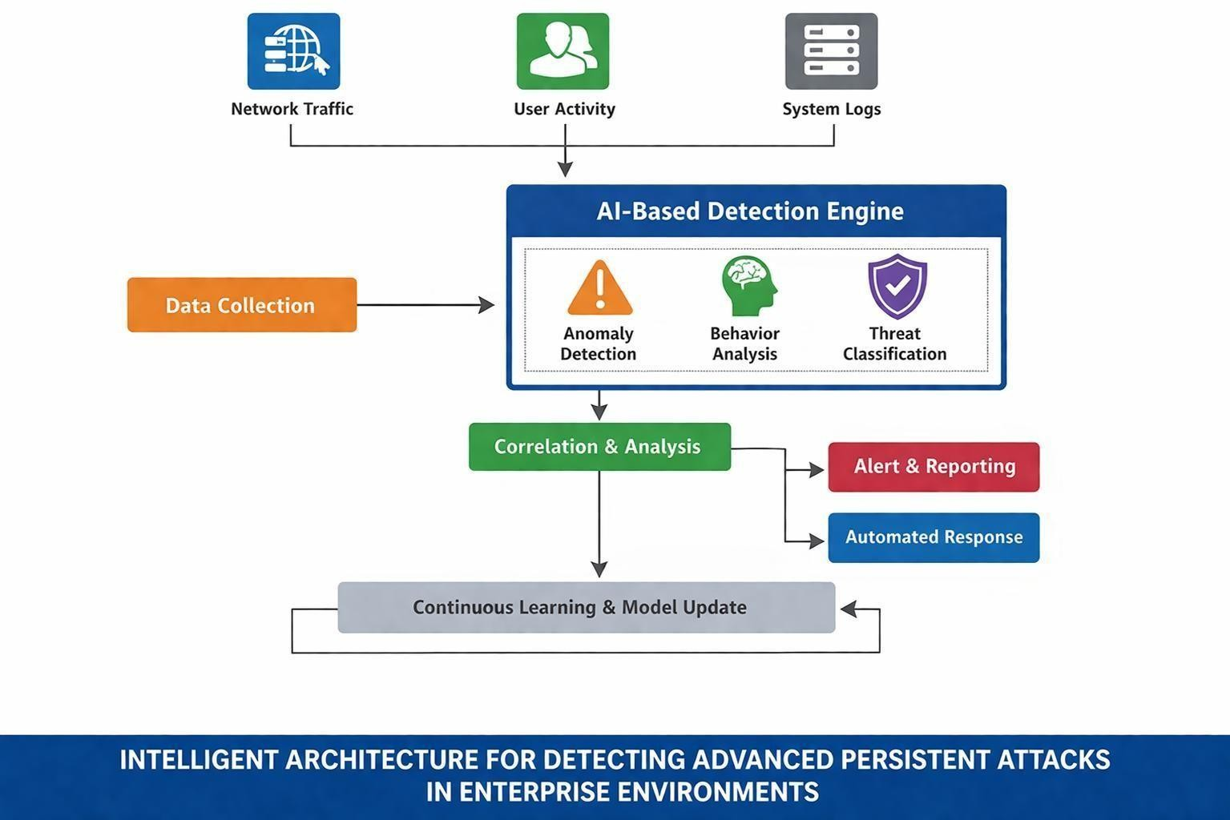
SYSTEM ARCHITECTURE

Slide 16
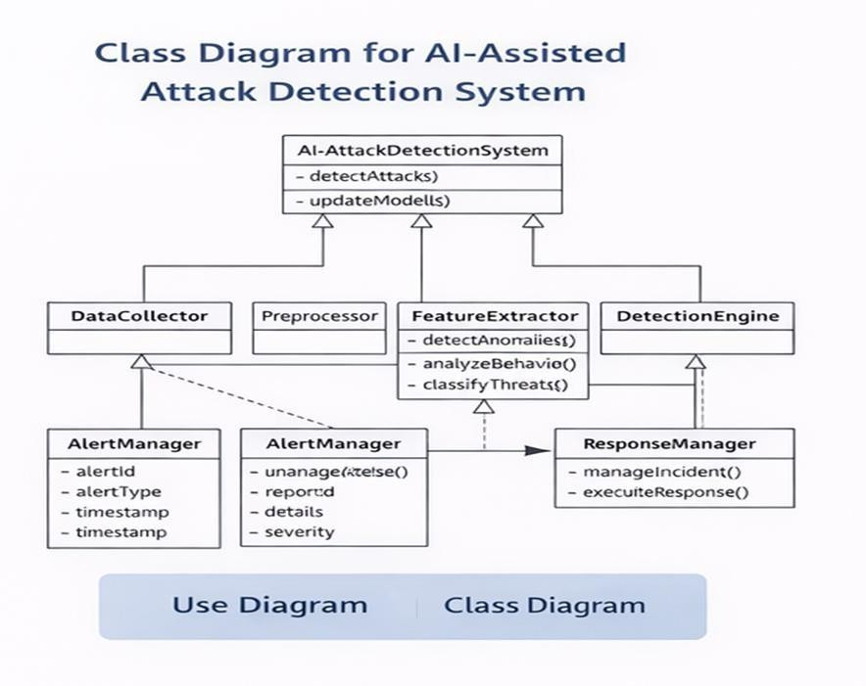
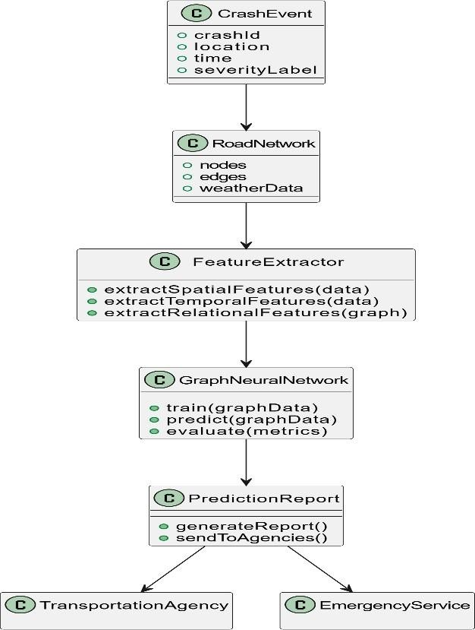
UML
Class Diagram:
A Class Diagram represents the structure of the system by showing classes, their attributes, and methods.
It also illustrates the relationships between different classes in the system.
This diagram helps in understanding how data and functions are organized in the application

Slide 17
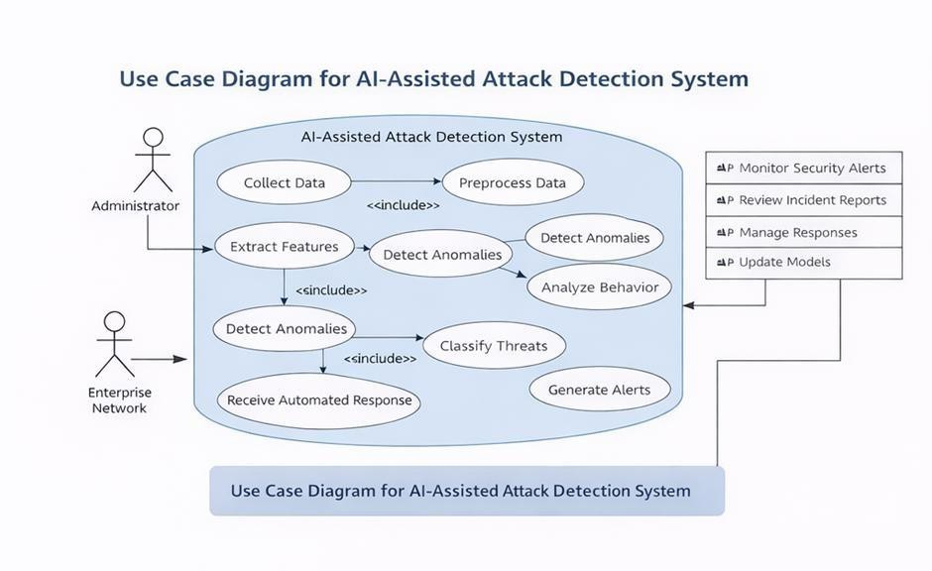
Use case Diagram:
A Use Case Diagram represents the interaction between users (actors) and the system.
It shows the different functionalities provided by the system.
The main purpose of a use case diagram is to show what system functions are performed for
which actor.

Slide 18
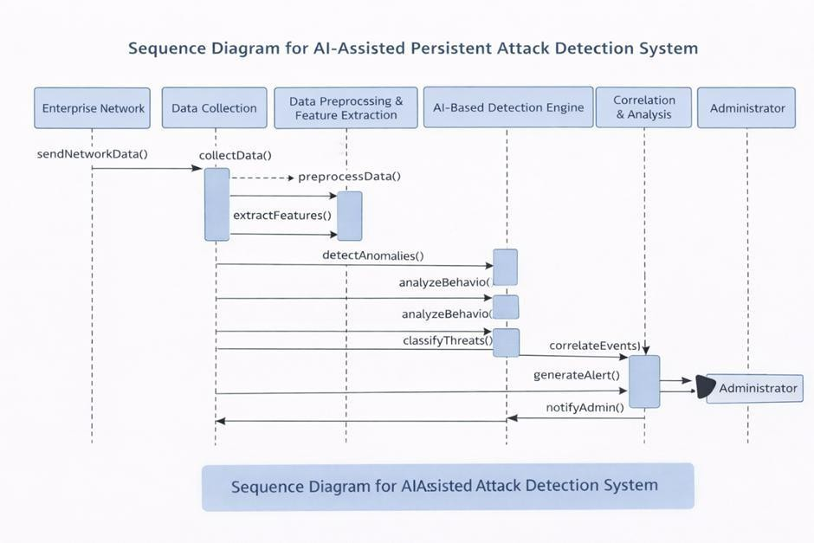
Sequence Diagram:
A Sequence Diagram shows the sequence of interactions between different components of the system over time.
It explains how messages are passed between objects to complete a task.
This means that the exact sequence of the interactions between the objects is represented step by step.

Slide 19
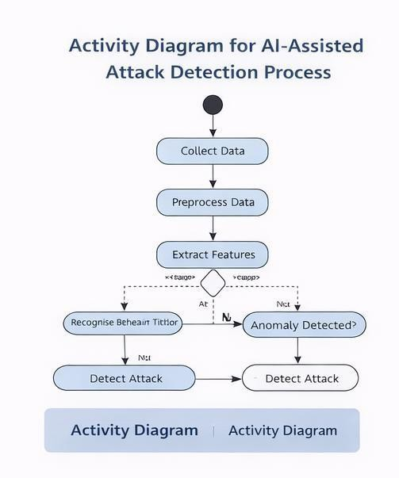
Activity Diagram:
Activity diagrams are graphic representations of workflows of stepwise activities and actions with support for choice, iteration and concurrency.
In the Unified Modeling Language, activity diagrams can be used to describe the business and operational step-by- step workflows of components in a system.

Slide 20
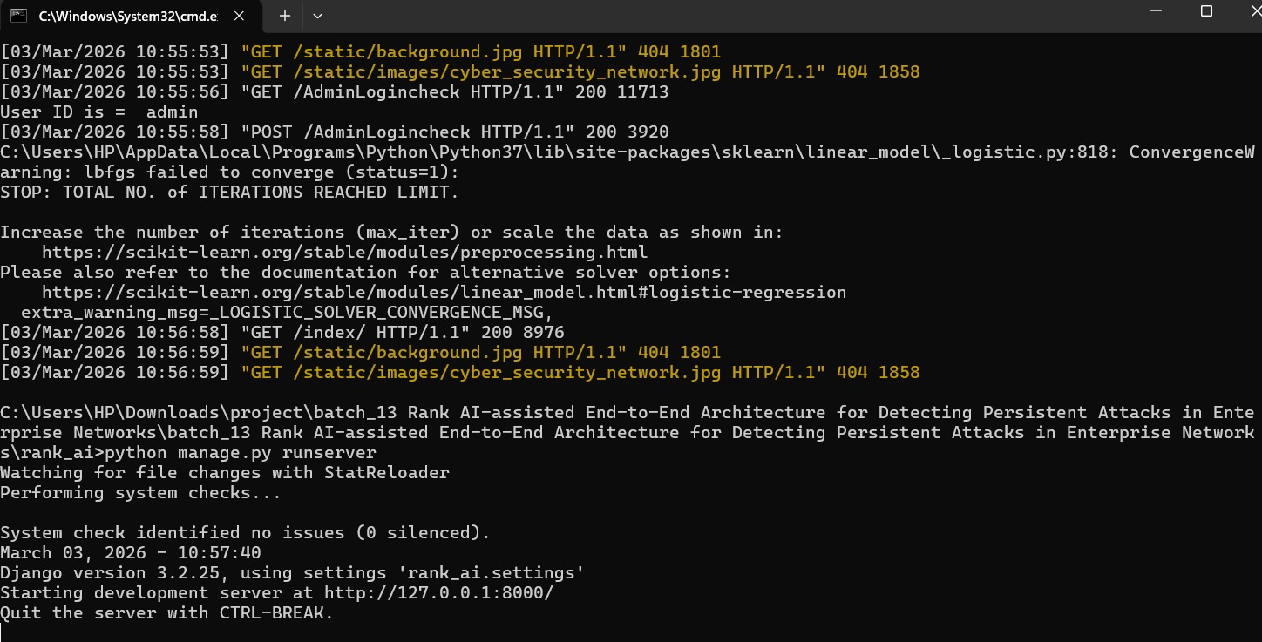

Slide 21
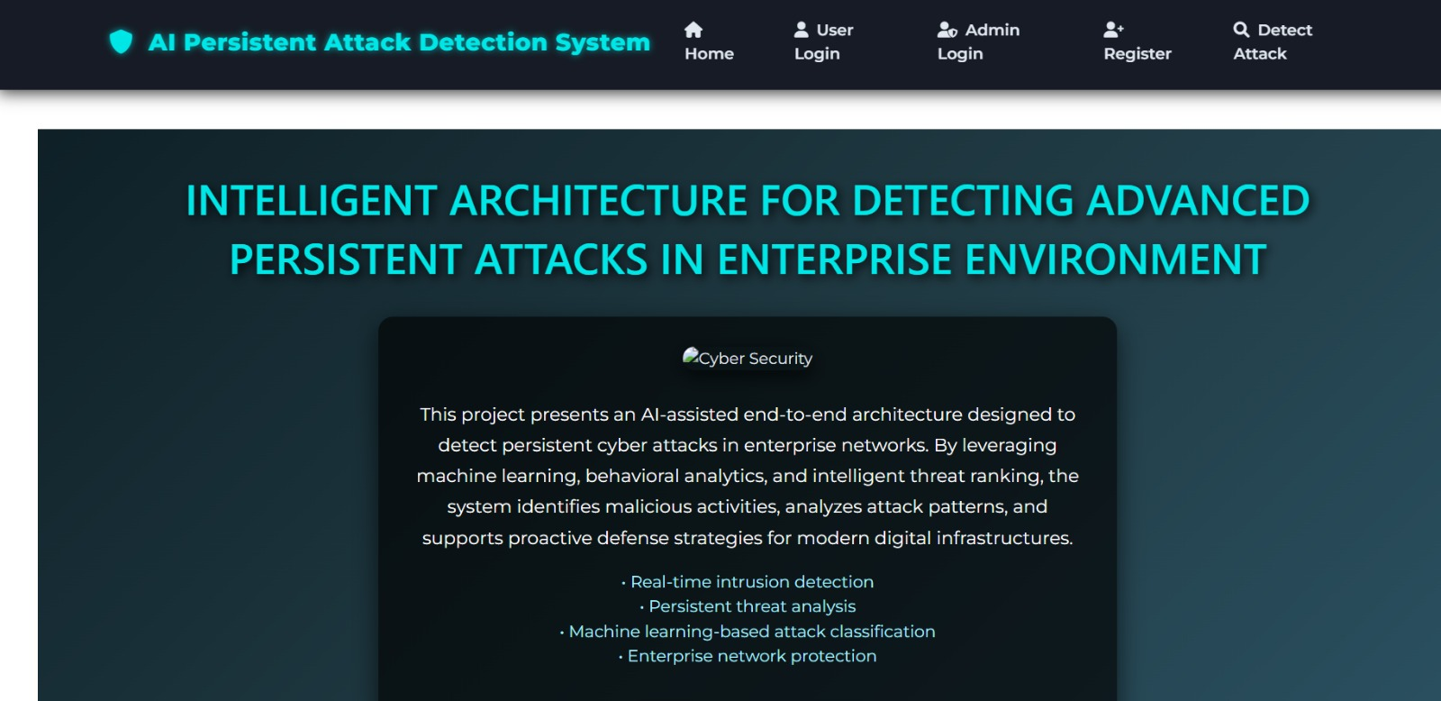

Slide 22
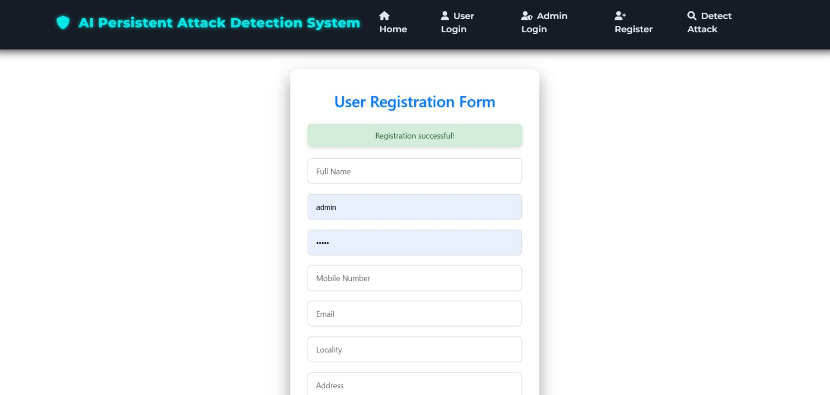

Slide 23
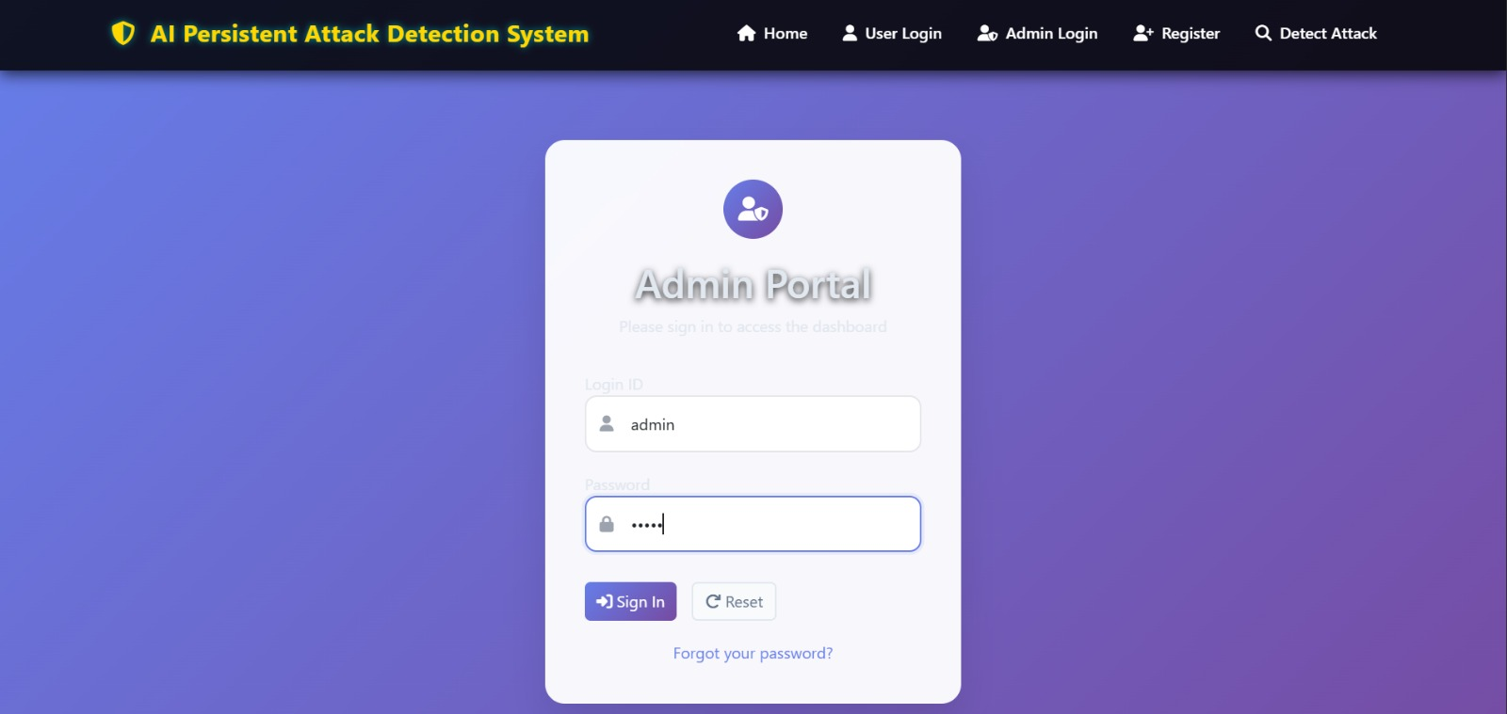

Slide 24
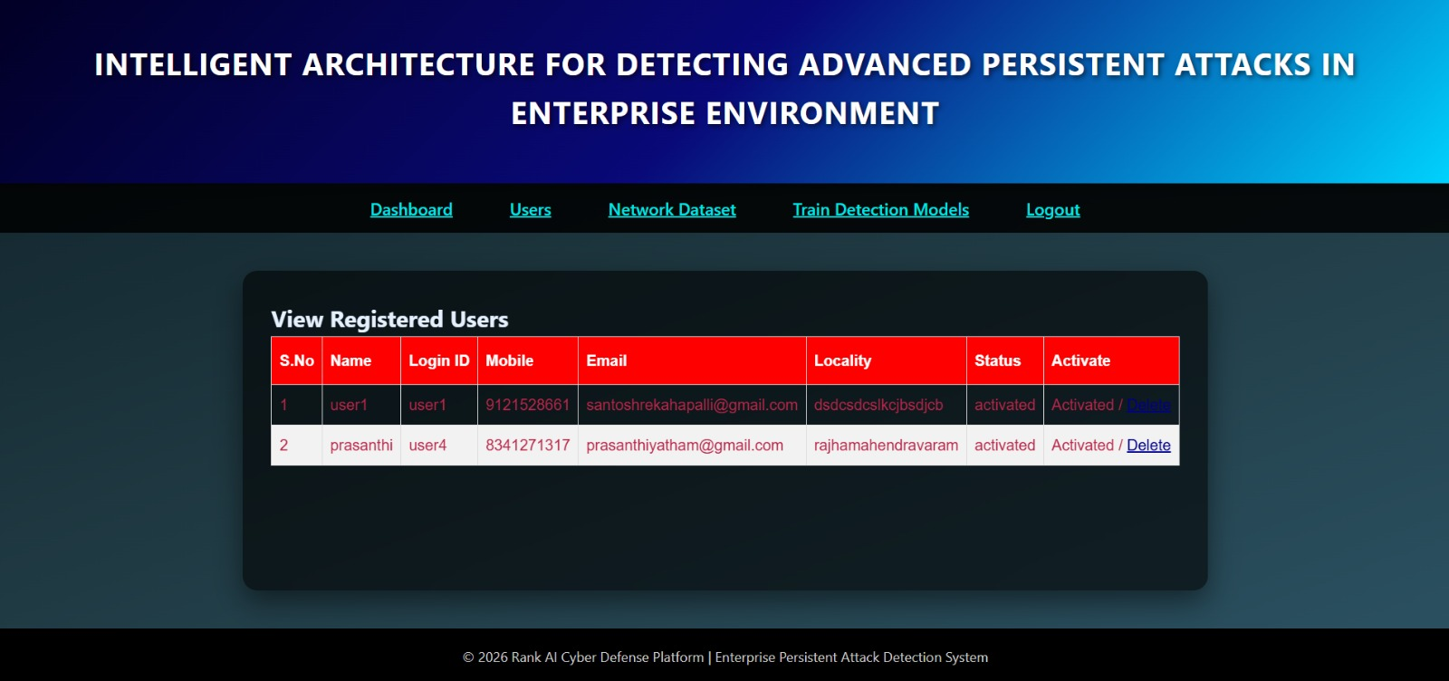

Slide 25
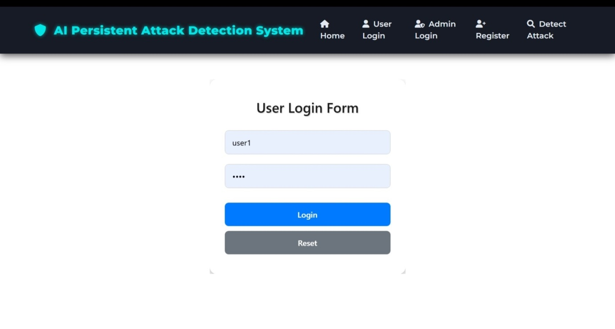

Slide 26
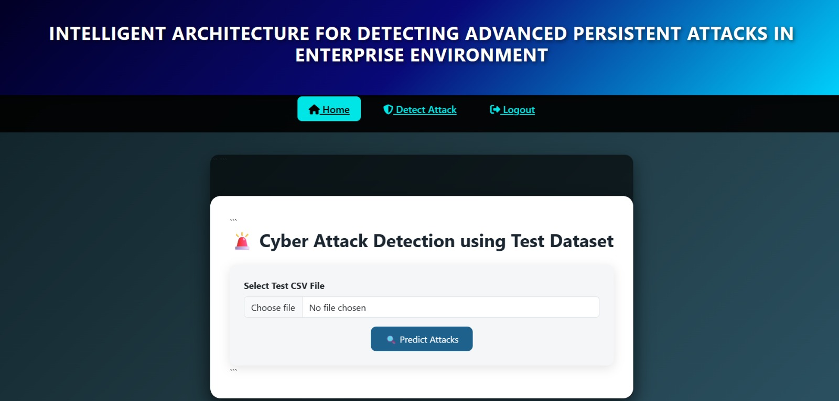

Slide 27
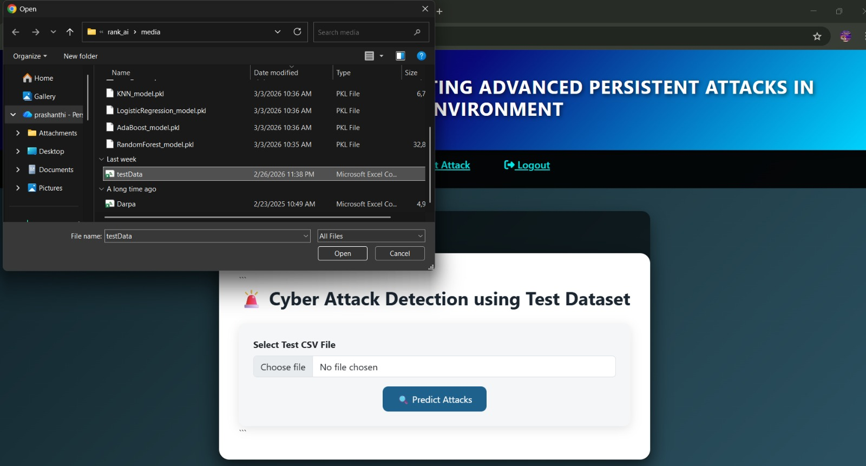

Slide 28
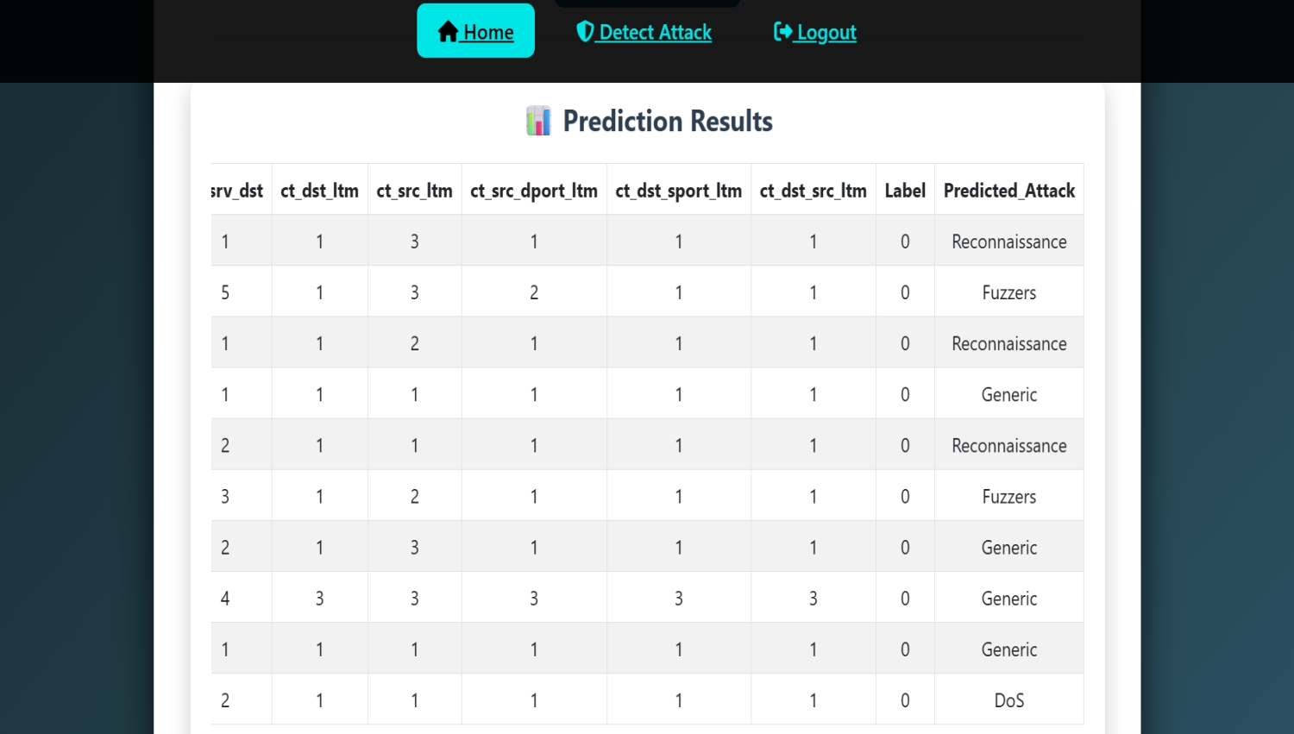

Slide 29
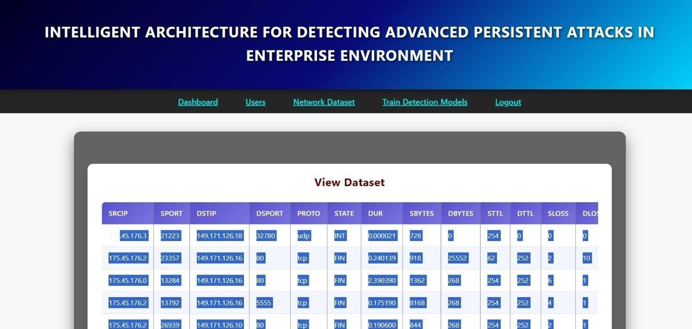

Slide 30
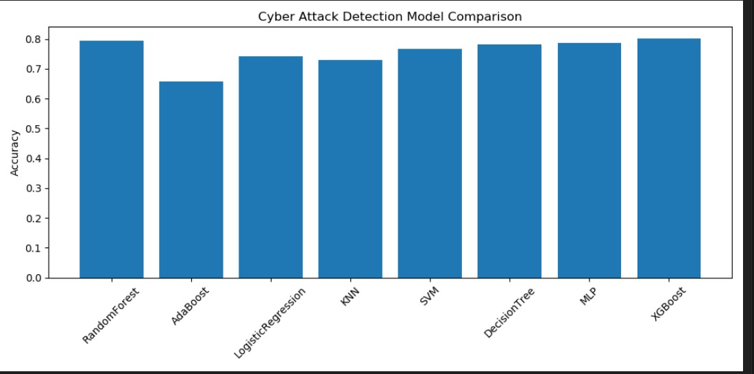

Slide 31
CONCLUSION
In this paper, we introduced RANK, an AI-assisted end-to-end architecture designed to detect persistent attacks in enterprise networks. By integrating deep learning models with behavioral analysis and network flow intelligence, RANK enhances the detection of stealthy and long-duration attacks such as Advanced Persistent Threats (APTs). The architecture leverages a multi-layered approach that incorporates traffic pre-processing, feature extraction, anomaly detection, and threat classification in a scalable and modular fashion. Our evaluation using simulated and real-world datasets demonstrates RANK’s ability to identify complex attack patterns with higher precision and recall compared to traditional intrusion detection systems.

Slide 32
REFERENCE
• J. Shukla, A. Kumar, and R. Hoda, "A survey on intrusion detection systems and techniques," Procedia Computer Science, vol. 167, pp. 636–645, 2020.
• N. Moustafa and J. Slay, "UNSW-NB15: A comprehensive data set for network intrusion detection systems," Military Communications and Information Systems Conference (MilCIS), Canberra, Australia, pp. 1–6, 2015.
• D. E. Denning, "An intrusion-detection model," IEEE Transactions on Software Engineering, vol. SE-13, no. 2, pp. 222–232, 1987.
• T. Chen et al., "Machine learning based mobile malware detection using highly imbalanced network traffic," Information Sciences, vol. 433–434, pp. 346–364, 2018.

Slide 33
THANK YOU

